Slide 1
#StopTheBias: Fact or Fiction?
Presenter: Matthew Stevenson
CS895 – February 26, 2019
Original Source: https://twitter.com/realDonaldTrump/status/1034907478566359041

Slide 2
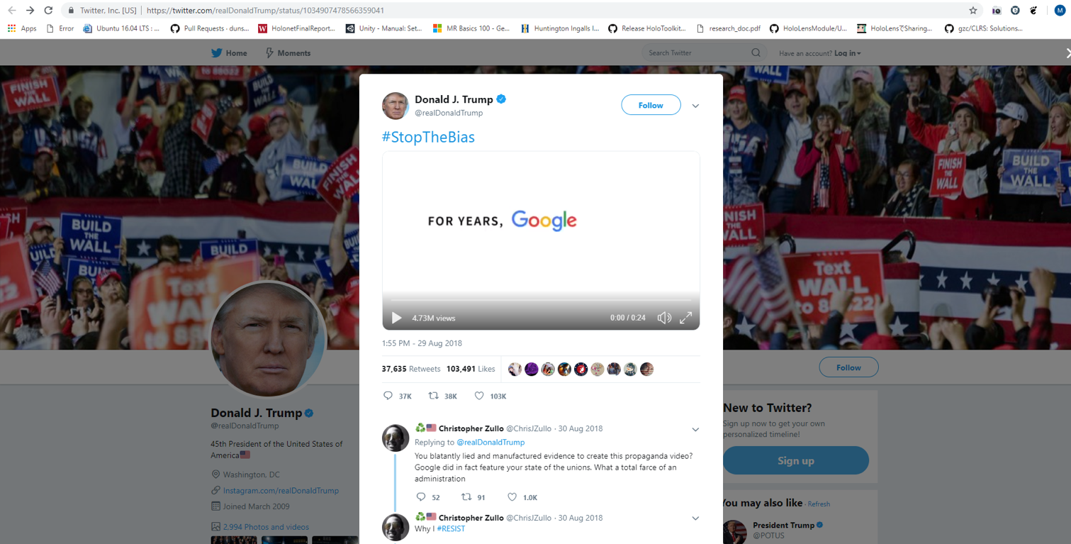
Source: https://twitter.com/realDonaldTrump/status/1034907478566359041

Slide 3

Source: https://www.youtube.com/watch?v=GzxMj9sGMbE

Slide 4
What Is Considered A State Of The Union Address?
“an annual message to Congress in which the president reports on the state of the nation and outlines a legislative program”
All branches are present within this address including the Executive, Legislative, and Judicial branches
It is a joint address meaning designated survivors are not present at this event
With this platform, the President can also speak directly to citizens
This address is considered a State of the Union address only after the president has retained office for at least one year
In the United States, this is a big deal for the nation and all governed bodies
Source: https://www.dictionary.com/browse/state--of--the--union--address

Slide 5
Source: https://www.history.com/news/state-of-the-union-explained

Slide 6
So What Was The Response To The Video?
Let Us take a look.

Slide 7
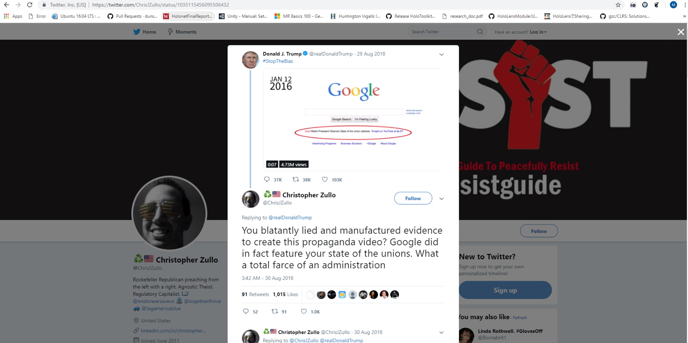
Source: https://twitter.com/ChrisJZullo/status/1035115456095506432

Slide 8
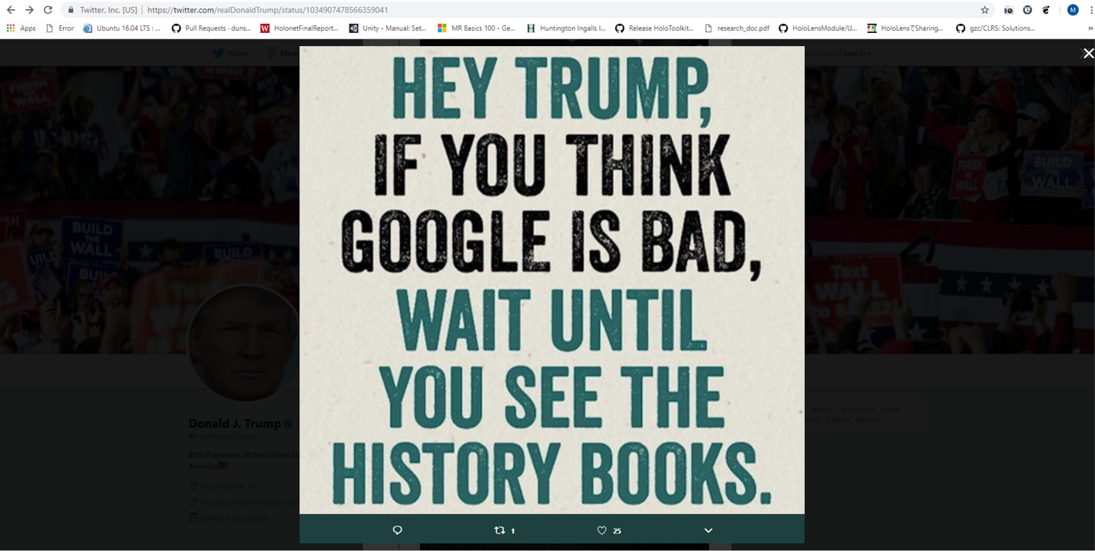
Source: https://twitter.com/realDonaldTrump/status/1034907478566359041

Slide 9
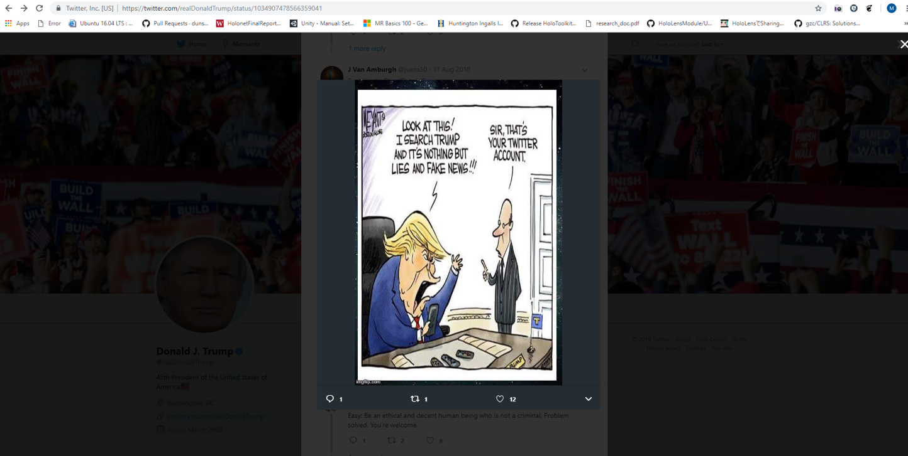
Source: https://twitter.com/realDonaldTrump/status/1034907478566359041

Slide 10
Are These Accusations Based On Fact Or Fiction?
Let’s Take A look at the evidence.

Slide 11
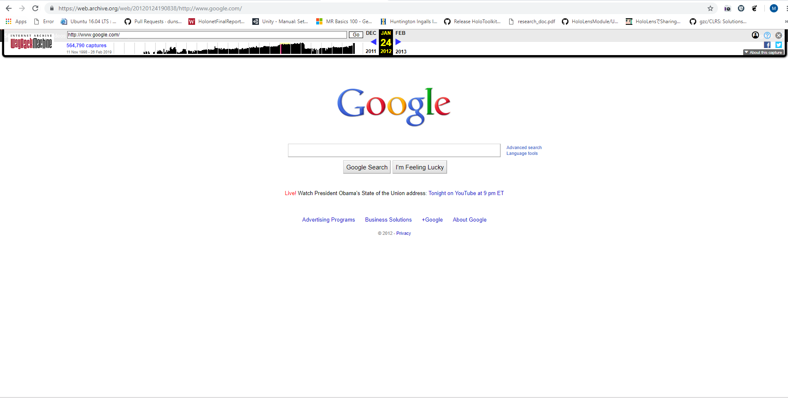

January 24th, 2012
State of the Union - Obama
Source: https://web.archive.org/web/20120124190838/http://www.google.com/

Slide 12

February 12th, 2013
State of the Union - Obama
Source: https://web.archive.org/web/20130212210553/http://www.google.com/

Slide 13
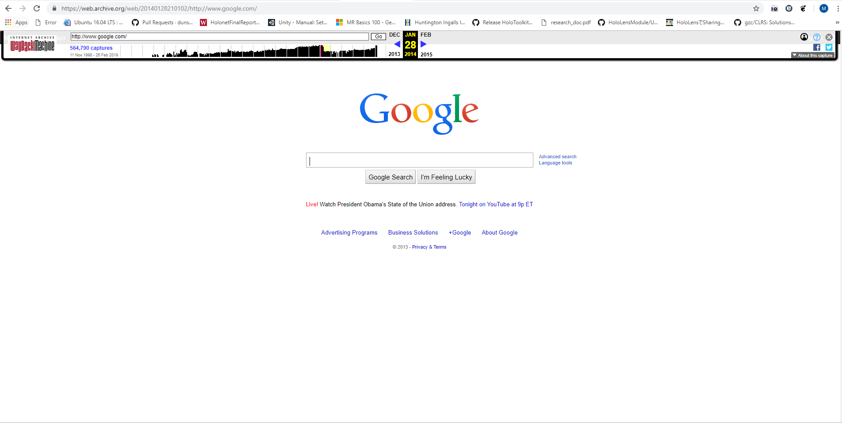
January 28th, 2014
State of the Union - Obama
Source: https://web.archive.org/web/20140128210102/http://www.google.com/

Slide 14
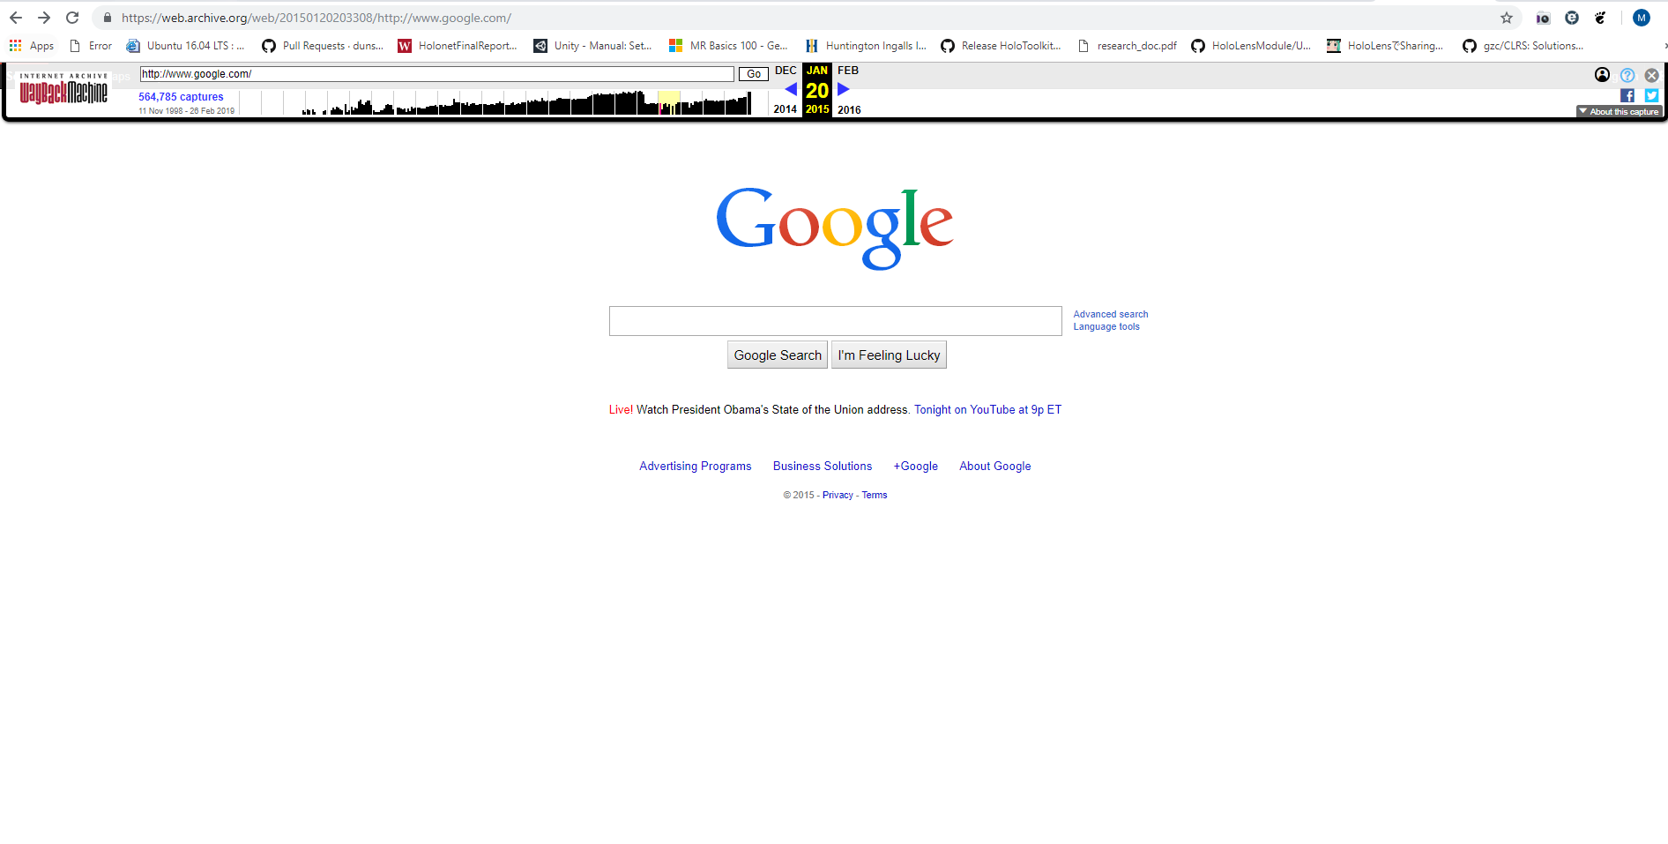
January 20th, 2015
State of the Union - Obama
Source: https://web.archive.org/web/20150120203308/http://www.google.com/

Slide 15
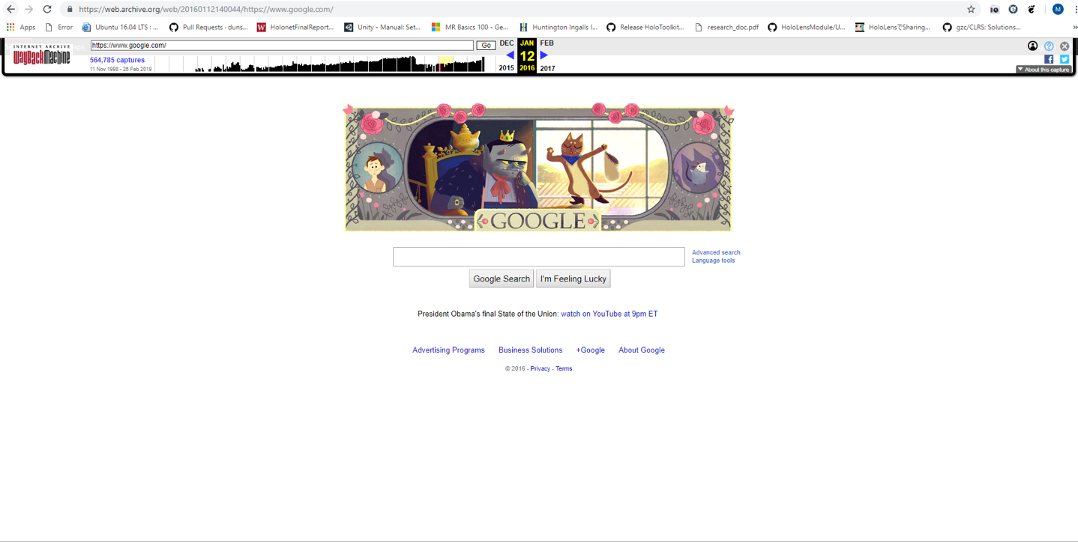
January 12th, 2016
State of the Union - Obama
Source: https://web.archive.org/web/20160112140044/https://www.google.com/

Slide 16
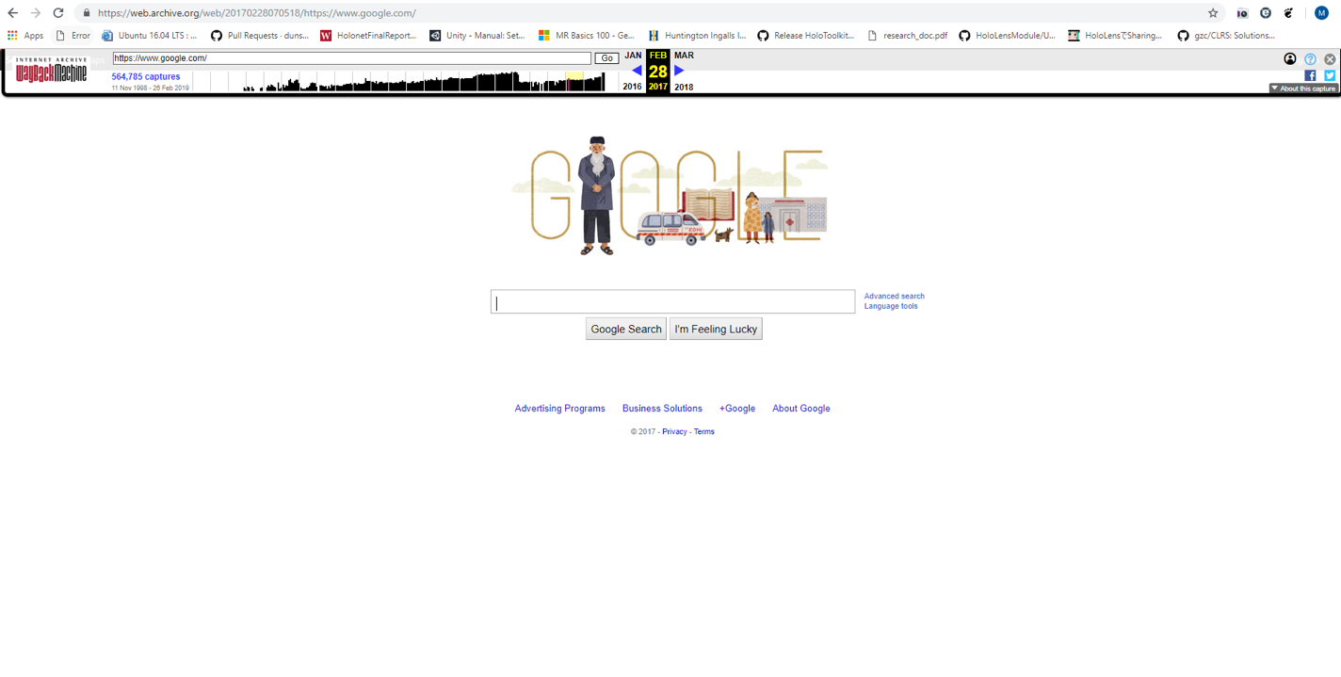
February 28th, 2017
State of the Union – Trump?
Source: https://web.archive.org/web/20170228070518/https://www.google.com/

Slide 17
So All The Pages Presented Were Correct…
But Why Did google not promote Trump?

Slide 18
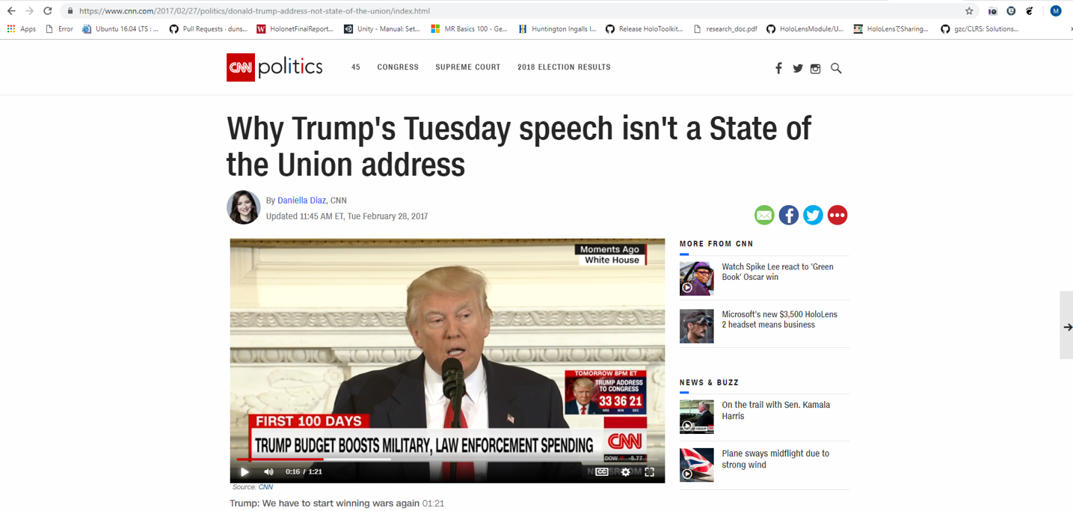
Source: https://www.cnn.com/2017/02/27/politics/donald-trump-address-not-state-of-the-union/index.html

Slide 19
When Was This Address Scheduled?
The speech was scheduled for 9PM EST.
The speech was the President’s first address to Congress.

Slide 20
February 29th, 2017
Potential Joint Address capture times
No captures shown within the range 2am - 4am after EST to GST conversion
Source: http://web.archive.org/web/20170701000000*/http://www.google.com/

Slide 21
But What About Obama’s First Address?
Let’s Find out

Slide 22
When Was This Address Scheduled?
The speech was scheduled for 9PM EST.
The speech was the President’s first address to Congress.

Slide 23
February 25th, 2009
Potential Joint Address capture times
No captures show within the range 2am - 4am after EST to GST conversion
Source: http://web.archive.org/web/20090401000000*/https://www.google.com/

Slide 24
Given This Information
What about the Next Page?

Slide 25
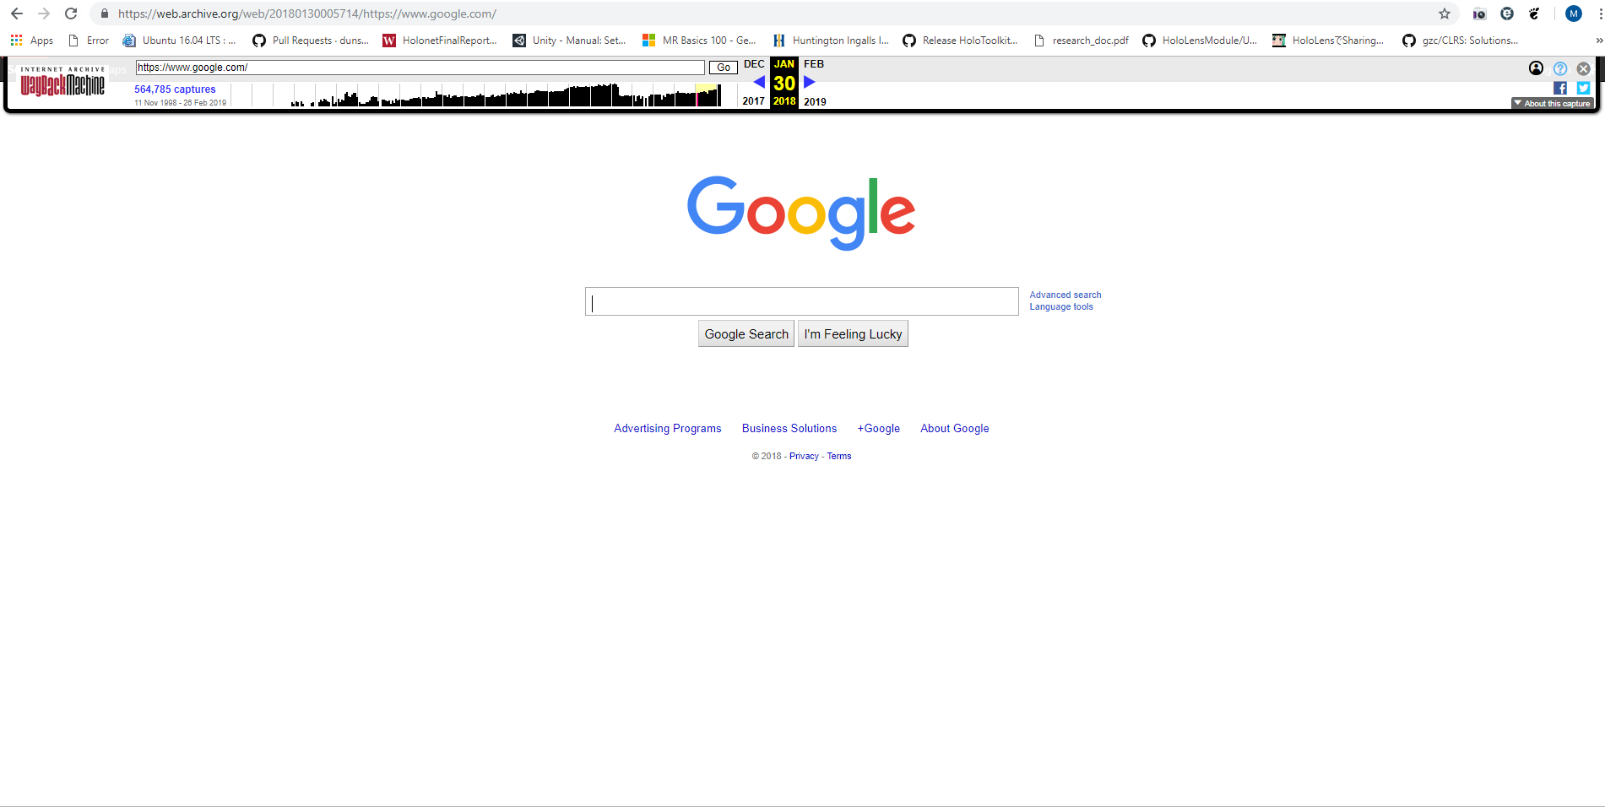
January 30th, 2018
State of the Union – Trump?
Source: https://web.archive.org/web/20180130005714/https://www.google.com/

Slide 26
So What Is Happening Here?
Let’s find Out

Slide 27
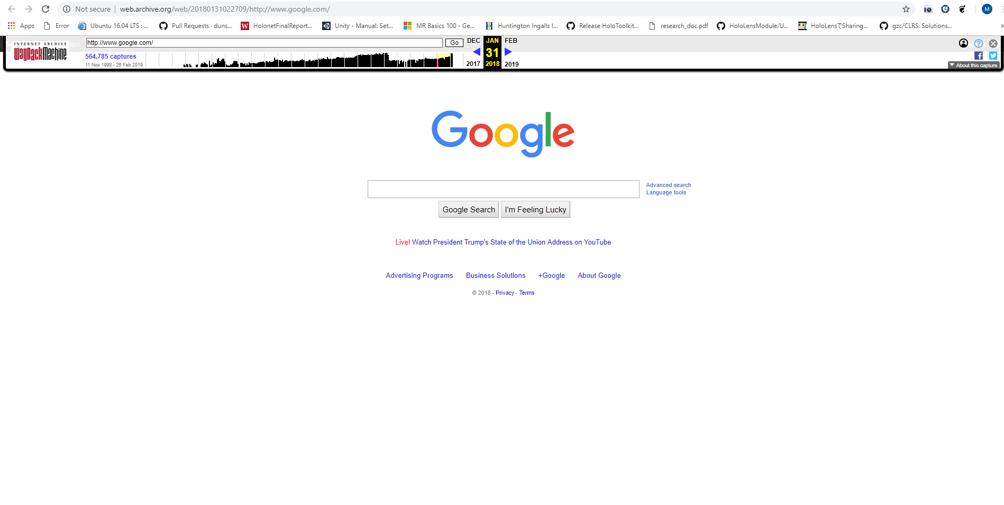
January 31st, 2018
State of the Union – Trump
Source: http://web.archive.org/web/20180131022709/http://www.google.com/

Slide 28
WayBack Machine’s Time Zone Misinterpretation
The creator of the video used the incorrect link due to being in a different time zone
The video is clear that it promotes an agenda even though the information is falsely represented

Slide 29
Now Back To The Video
Displays false information
Is an example where false information disrupts public opinion
Proves social media quickly unravels due to politics

Slide 30
Contact Information:
Twitter: @mstev0du
Github: https://github.com/mst3v3nsn
Google Groups: https://groups.google.com/forum/#!forum/cs895-s19

